Slide 1
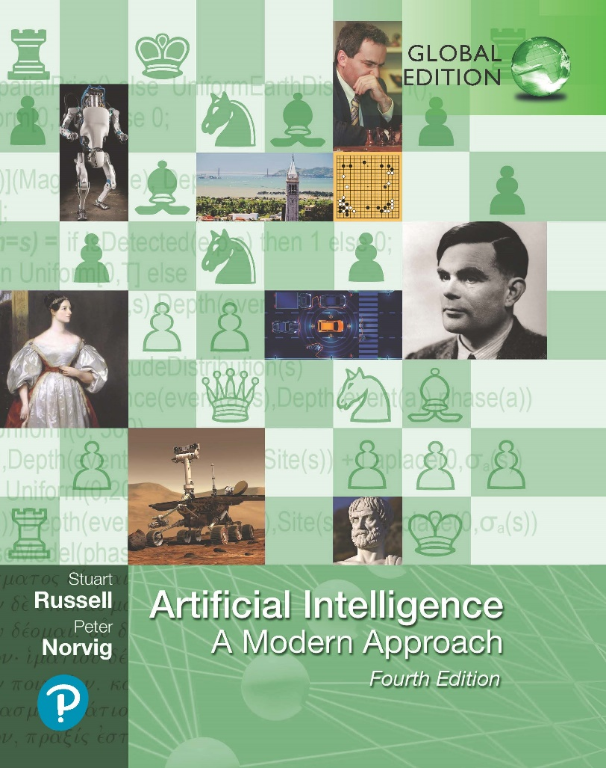
Artificial Intelligence: A Modern Approach
Fourth Edition, Global Edition
Chapter 12
Quantifying Uncertainty
© 2022 Pearson Education Ltd.

Slide 2
Outline
Acting Under Uncertainty
Basic Probability Notation
Inference Using Full Joint Distributions
Independence
Bayes' Rule and Its Use
Naive Bayes Models
The Wumpus World Revisited
© 2022 Pearson Education Ltd.

Slide 3
Acting Under Uncertainty
Real world problems contain uncertainties due to:
partial observability,
nondeterminism, or
adversaries.
Example of dental diagnosis using propositional logic
Toothache ⇒ Cavity.
However inaccurate, not all patients with toothaches have cavities
Toothache ⇒ Cavity ∨ GumProblem ∨ Abscess...
In order to make the rule true, we have to add an almost unlimited list of possible problems.
The only way to fix the rule is to make it logically exhaustive

Slide 4
Acting Under Uncertainty
An agent strives to choose the right thing to do—the rational decision—depends on both the relative importance of various goals and the likelihood that, and degree to which, they will be achieved.
Large domains such as medical diagnosis fail to three main reasons:
Laziness: It is too much work to list the complete set of antecedents or consequents needed to ensure an exceptionless rule
Theoretical ignorance: Medical science has no complete theory for the domain
Practical ignorance: Even if we know all the rules, we might be uncertain about a particular patient because not all the necessary tests have been or can be run.
An agent only has a degree of belief in the relevant sentences.

Slide 5
Acting Under Uncertainty
Probability theory
tool to deal with degrees of belief of relevant sentences.
summarizes the uncertainty that comes from our laziness and ignorance
Uncertainty and rational decisions
An requires preference among different possible outcomes of various plans
Utility Theory: the quality of the outcome being useful
Every state has a degree of usefulness/utility
Higher utility is preferred
Decision Theory: Preferences (Utility Theory) combined with probabilities
Decision theory = probability theory + utility theory.
agent is rational if and only if it chooses the action that yields the highest expected utility, averaged over all the possible outcomes of the action.
principle of maximum expected utility (MEU).

Slide 6
Acting Under Uncertainty
Function of a decision-theoretic agent that selects rational actions.
function DT-AGENT( percept) returns an action
persistent: belief state, probabilistic beliefs about the current state of the world
action, the agent’s action
update belief state based on action and percept
calculate outcome probabilities for actions,
given action descriptions and current belief state
select action with highest expected utility
given probabilities of outcomes and utility information
return action

Slide 7
Basic Probability Notation
For our agent to represent and use probabilistic information, we need a formal language.
Sample space: the set of all possible worlds
The possible worlds are mutually exclusive and exhaustive
A fully specified probability model associates a numerical probability P(ω) with each possible world.
The basic axioms of probability theory say that every possible world has a probability between 0 and 1 and that the total probability of the set of possible worlds is 1:
0 ≤ P(ω) ≤ 1 for every ω and ω∈Ω
Unconditional or prior probability: degrees of belief in propositions in the absence of any other information

Slide 8
Basic Probability Notation
Conditional or posterior probability: given evidence that has happened, degree of belief of new event
Make use of unconditional probabilities
Probability of a given b:
P(a|b) = P(a∧b)
P(b)
Can also written as:
P(a∧b) = P(a|b)P(b) .
Example of rolling fair dice, rolling doubles when the first dice is 5
P(doubles|Die₁ = 5) = P(doubles∧Die₁ = 5) .
P(Die₁ = 5)

Slide 9
Basic Probability Notation
Factored representation: possible world is represented by a set of variable/value pairs.
Variables in probability theory are called random variables, and their names begin with an uppercase letter. (Total and Die₁)
Sometimes we will want to talk about the probabilities of all the possible values of a random variable. We could write:
P(Weather = sun) = 0.6
P(Weather = rain) = 0.1
P(Weather = cloud) = 0.29
P(Weather = snow) = 0.01 ,
Abbreviation of this will be:
P(Weather) = (0.6, 0.1, 0.29, 0.01),
P statement defines a probability distribution for the random variable Weather

Slide 10
Inference Using Full Joint Distributions
Start with the joint distribution:
 | toothache |  | toothache
 | catch | catch | catch | catch
cavity | .108 | .012 | .072 | .008
cavity | .016 | .064 | .144 | .576
For any proposition φ, sum the atomic events where it is true:
P (φ) = Σ_{ω:ω|=φ}P (ω)

Slide 11
Inference Using Full Joint Distributions
Start with the joint distribution:
 | toothache |  | toothache
 | catch | catch | catch | catch
cavity | .108 | .012 | .072 | .008
cavity | .016 | .064 | .144 | .576
For any proposition φ, sum the atomic events where it is true:
P (φ) = Σ_{ω:ω|=φ}P (ω)
P (toothache) = 0.108 + 0.012 + 0.016 + 0.064 = 0.2

Slide 12
Inference Using Full Joint Distributions
Start with the joint distribution:
 | toothache |  | toothache
 | catch | catch | catch | catch
cavity | .108 | .012 | .072 | .008
cavity | .016 | .064 | .144 | .576
For any proposition φ, sum the atomic events where it is true:
P (φ) = Σ_{ω:ω|=φ}P (ω)
P (cavity∨toothache) = 0.108+0.012+0.072+0.008+0.016+0.064 = 0.28

Slide 13
Inference Using Full Joint Distributions
Start with the joint distribution:
 | toothache |  | toothache
 | catch | catch | catch | catch
cavity | .108 | .012 | .072 | .008
cavity | .016 | .064 | .144 | .576
Can also compute conditional probabilities:
P (¬cavity ∧ toothache)
P (¬cavity|toothache) =
P (toothache) 0.016 + 0.064
=
= 0.4
0.108 + 0.012 + 0.016 + 0.064

Slide 14
Normalization
 | toothache |  |  |  |  |  | toothache
 | catch |  |  | catch |  |  | catch | catch
cavity |  | .108 |  |  | .012 |  | .072 | .008
cavity |  | .016 |  |  | .064 |  | .144 | .576
Denominator can be viewed as a normalization constant α
P(Cavity|toothache) = α P(Cavity, toothache)
= α [P(Cavity, toothache, catch) + P(Cavity, toothache, ¬catch)]
= α [(0.108, 0.016) + (0.012, 0.064)]
= α (0.12, 0.08) = (0.6, 0.4)
General idea: compute distribution on query variable
by fixing evidence variables and summing over hidden variables

Slide 15
Inference Using Full Joint Distributions
Let X be all the variables. Typically, we want
the posterior joint distribution of the query variables Y
given specific values e for the evidence variables E
Let the hidden variables be H = X − Y − E
Then the required summation of joint entries is done by summing out the hidden variables:
P(Y|E = e) = αP(Y, E = e) = αΣ_{h}P(Y, E = e, H = h)
The terms in the summation are joint entries because Y, E, and H together exhaust the set of random variables
Obvious problems:
Worst-case time complexity O(d^{n}) where d is the largest arity
Space complexity O(d^{n}) to store the joint distribution
How to find the numbers for O(d^{n}) entries???

Slide 16
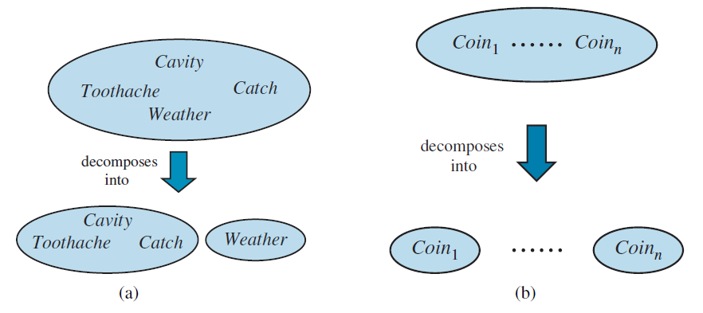
Independence
Two examples of factoring a large joint distribution into smaller distributions, using absolute independence. (a) Weather and dental problems are independent. (b) Coin flips are independent.
P(a|b) = P(a) or P(b|a) = P(b) or P(a∧b) = P(a)P(b) .
one’s dental problems influence the weather thus:
P(toothache, catch, cavity, cloud) = P(cloud |toothache, catch cavity) P(toothache, catch, cavity) .
P(cloud |toothache, catch, cavity) = P(cloud) .
P(toothache, catch, cavity, cloud) = P(cloud)P(toothache, catch, cavity)

Slide 17
Bayes' Rule and Its Use
Bayes’ rule is derived from the product rule
P(a∧b) = P(a|b)P(b) and P(a∧b) = P(b|a)P(a) .
Equating the two right-hand sides and dividing by P(a), we get
P(b|a) =P(a|b)P(b) .
P(a)
Often, we perceive as evidence the effect of some unknown cause and we would like to determine that cause. In that case, Bayes’ rule becomes
P(cause|effect) =P(effect |cause)P(cause)
P(effect)
The conditional probability P(effect|cause) quantifies the relationship in the causal direction, whereas P(cause|effect) describes the diagnostic direction.

Slide 18
Bayes' Rule and Its Use
For example, a doctor knows that the disease meningitis causes a patient to have a stiff neck, say, 70% of the time. The doctor also knows some unconditional facts: the prior probability that any patient has meningitis is 1/50,000, and the prior probability that any patient has a stiff neck is 1%. Letting s be the proposition that the patient has a stiff neck and m be the proposition that the patient has meningitis, we have
P(s|m) = 0.7
P(m) = 1/50000
P(s) = 0.01
P(m|s) = P(s|m)P(m) = 0.7 × 1/50000 = 0.0014
P(s) 0.01
That is, we expect only 0.14% of patients with a stiff neck to have meningitis. Notice that even though a stiff neck is quite strongly indicated by meningitis (with probability 0.7), the probability of meningitis in patients with stiff necks remains small. This is because the prior probability of stiff necks (from any cause) is much higher than the prior for meningitis.

Slide 19
Bayes’ Rule and conditional independence
P(Cavity|toothache ∧ catch)
= α P(toothache ∧ catch|Cavity)P(Cavity)
= α P(toothache|Cavity)P(catch|Cavity)P(Cavity)
This is an example of a naive Bayes model:
P(Cause, Effect₁, . . . , Effect_{n}) = P(Cause)Π_{i}P(Effect_{i}|Cause)
Cavity
Cause
Toothache
Catch
Effect₁
Effect_{n}
Total number of parameters is linear in n

Slide 20
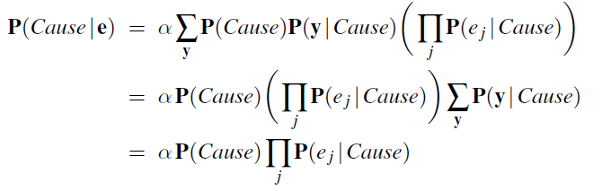
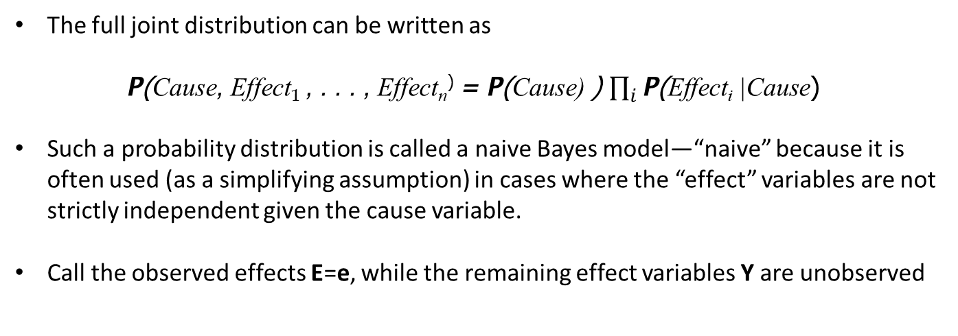
Naïve Bayes Models
The full joint distribution can be written as
P(Cause, Effect₁ , . . . , Effect_{n}⁾ = P(Cause) ) $\prod_{i}{\text{P}\text{(}\text{Effect}\text{i}\text{ |}\text{Cause}\text{) }}$
Such a probability distribution is called a naive Bayes model—“naive” because it is often used (as a simplifying assumption) in cases where the “effect” variables are not strictly independent given the cause variable.
Call the observed effects E=e, while the remaining effect variables Y are unobserved

Slide 21
The Wumpus World Revisited
1,4 | 2,4 | 3,4 | 4,4
1,3 | 2,3 | 3,3 | 4,3
1,2 B OK | 2,2 | 3,2 | 4,2
1,1 OK | 2,1 B OK | 3,1 | 4,1
P_{ij} = true iff [i, j] contains a pit
B_{ij} = true iff [i, j] is breezy
Include only B_{1,1}, B_{1,2}, B_{2,1} in the probability model

Slide 22
Specifying the probability model
The full joint distribution is P(P_{1,1}, . . . , P_{4,4}, B_{1,1}, B_{1,2}, B_{2,1})
Apply product rule: P(B_{1,1}, B_{1,2}, B_{2,1} | P_{1,1}, . . . , P_{4,4})P(P_{1,1}, . . . , P_{4,4})
(Do it this way to get P (Effect|Cause).)
First term: 1 if pits are adjacent to breezes, 0 otherwise
Second term: pits are placed randomly, probability 0.2 per square:
_{) = Π}4,4
P(P , . . . , P
P(P ) = 0.2^{n} × 0.8^{16−n}
1,1 4,4
i,j = 1,1
i,j
for n pits.

Slide 23
Observations and query
We know the following facts:
b = ¬b1,1 ∧ b1,2 ∧ b2,1
known = ¬p_{1,1} ∧ ¬p_{1,2} ∧ ¬p_{2,1}
Query is P(P_{1,3}|known, b)
Define Unknown = P_{ij}s other than P_{1,3} and Known
For inference by enumeration, we have
P(P_{1,3}|known, b) = αΣ_{unknown}P(P_{1,3}, unknown, known, b)
Grows exponentially with number of squares!

Slide 24
Using conditional independence
Basic insight: observations are conditionally independent of other hidden squares given neighbouring hidden squares
1,4 2,4 3,4 4,4
1,3
2,3
3,3 4,3
OTHER
QUERY
1,2
2,2
3,2
4,2
1,1
2,1
KNOWN
FRIN₃G_{,1}E
4,1
Define Unknown = Fringe ∪ Other
P(b|P_{1,3}, Known, Unknown) = P(b|P_{1,3}, Known, Fringe)
Manipulate query into a form where we can use this!

Slide 25
Using conditional independence contd.
P(P_{1,3}|known, b) = α _{unk} _{nown} P(P_{1,3}, unknown, known, b)
= α P(b|P_{1,3}, known, unknown)P(P_{1,3}, known, unknown)
unknown
= α P(b|known, P_{1,3}, fringe, other)P(P_{1,3}, known, fringe, other)
f ringe other
= α P(b|known, P_{1,3}, fringe)P(P_{1,3}, known, fringe, other)
f ringe other
= α P(b|known, P_{1,3}, fringe) P(P
1,3
, known, fringe, other)
fringe other
= α P(b|known, P_{1,3}, fringe) P(P_{1,3})P (known)P (fringe)P (other)
f ringe other
= α P (known)P(P_{1,3}) _{f r} _{inge} P(b|known, P_{1,3}, fringe)P (fringe) _{ot} _{her} P (other)
= α P(P_{1,3}) _{f r} _{inge} P(b|known, P_{1,3}, fringe)P (fringe)

Slide 26
Using conditional independence contd.
1,3
1,2 B OK | 2,2
1,1 OK | 2,1 B OK | 3,1
1,3
1,2 B OK | 2,2
1,1 OK | 2,1 B OK | 3,1
1,3
1,2 B OK | 2,2
1,1 OK | 2,1 B OK | 3,1
1,3
1,2 B OK | 2,2
1,1 OK | 2,1 B OK | 3,1
1,3
1,2 B OK | 2,2
1,1 OK | 2,1 B OK | 3,1
0.2 x 0.2 = 0.04
0.2 x 0.8 = 0.16
0.8 x 0.2 = 0.16
0.2 x 0.2 = 0.04
0.2 x 0.8 = 0.16
P(P_{1,3}|known, b) = α (0.2(0.04 + 0.16 + 0.16), 0.8(0.04 + 0.16))
≈ (0.31, 0.69)
P(P_{2,2}|known, b) ≈ (0.86, 0.14)

Slide 27
Summary
Probabilities express the agent’s inability to reach a definite decision regarding the truth of a sentence.
Decision theory combines the agent’s beliefs and desires, defining the best action as the one that maximizes expected utility.
Basic probability statements include prior or unconditional probabilities and posterior or conditional probabilities over simple and complex propositions.
The axioms of probability constrain the probabilities of logically related propositions.
The full joint probability distribution specifies the probability of each complete assignment of values to random variables
Absolute independence between subsets of random variables allows the full joint distribution to be factored into smaller joint distributions, greatly reducing its complexity.
Bayes’ rule allows unknown probabilities to be computed from known conditional probabilities, usually in the causal direction.
Conditional independence brought about by direct causal relationships in the domain allows the full joint distribution to be factored into smaller, conditional distributions.

